Slide 1

Book Recommendation System
Presented By : Group 5
Pratik Mahadev Bhoud
Dibin K Sunil
Chelloju Sreehitha
Rahul Kumar Yadav

Slide 2
Contents
Project Architecture
Introduction to Recommendation System
Dataset Details
EDA & Data Preprocessing
Data Visualizations
Model Building
Deployment

Slide 3
Project Architecture
1. Introduction to Recommendation System
2. Data Preparation 1. Import the Libraries
2. Load the Datasets
3. Data Preprocessing/EDA 1. Rename Column Names
2. Check Duplicates
3. Missing Value Treatment
4. Construct New Columns
4. Data Visualizations 1. Univariate Analysis – Histogram ,Box Plot
2. Bivariate Analysis – Bar Chart ,Line Plot
5. Model Building 1. Rating Count ,Popularity Based
2. Collaborative Based Recommendation System
6. Model Deployment Using Flask or Streamlit

Slide 4
Introduction to Recommendation System
Recommender System is an automatic suggestion system that provides suggestions on things just like your friends, relatives, or neighbors give suggestions. A recommender system will help customers to find interesting things, reduce the number of options, and discover new things. At the same time, it also helps businesses to increase sales, increase user satisfaction and understand user needs. You have also seen YouTube where they recommend videos based on your previously watched videos. Netflix recommends related movies based on previously watched movies.
Functions of Recommender System :
1. It helps user to deal with information overload by filtering recommendations of product.
2. It helps businesses to generate more profits by selling more products.

Slide 5
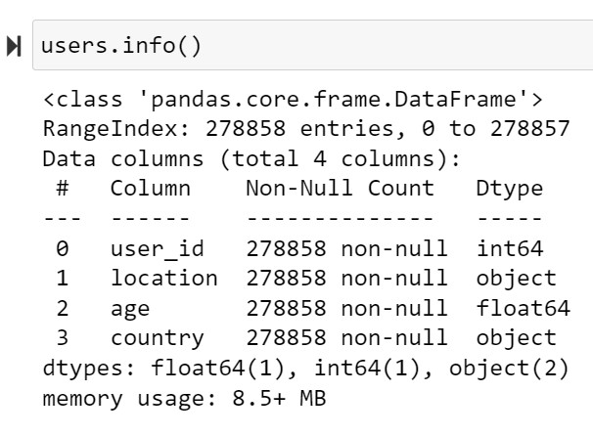
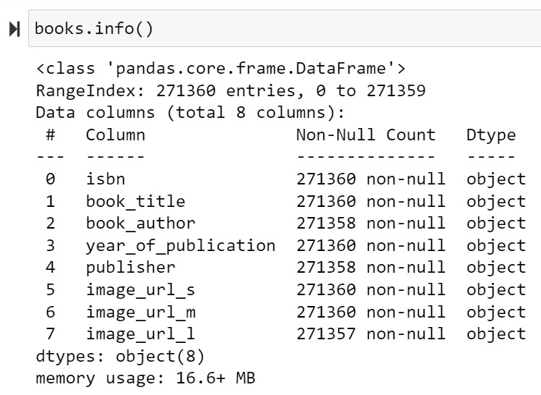
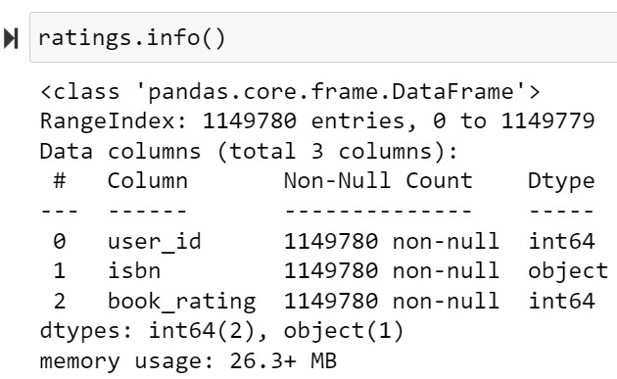
Dataset Details
The dataset comprises 3 files :
Users
No. of Rows – 278858
No. of Columns - 4
Books
No. of Rows – 271360
No. of Columns - 8
Ratings
No. of Rows – 1149780
No. of Columns - 3

Slide 6
EDA and Data Preprocessing
1. Books Dataset
- Checking for null values and missing data.
- Changing column names for easy recognition.
- In the publisher column, replacing missing values with others.
- In the Year Of Publication column, replacing two object data entries ("DK Publishing Inc" and "Gallimard") with 2002 , respectively.
2. In Users Dataset
- In the Users dataset, finding unique values in the Age column and fixing values <5 and values>105 with median age of each country they belong to.
- In the Location column, splitting combined information about the city, state, and country into three different columns and creating a new column .
3. Rating Dataset
- Checking that the Book-rating and User-ID columns are of numerical type.
- Removing extra characters from the ISBN column.

Slide 7
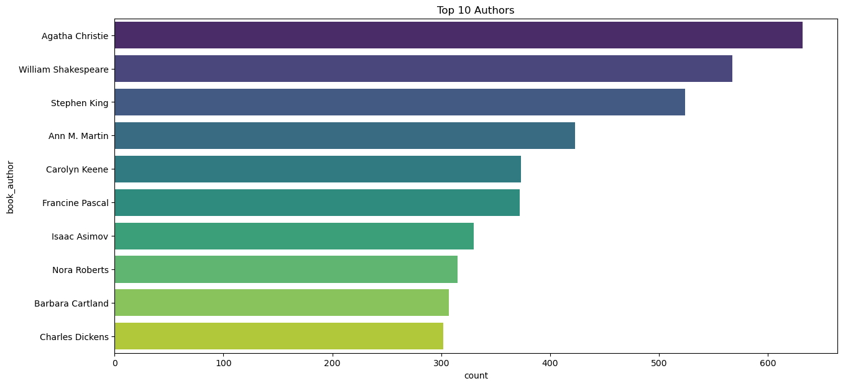
Data Visualizations
1. Top 10 Authors with Most Written Books

Slide 8
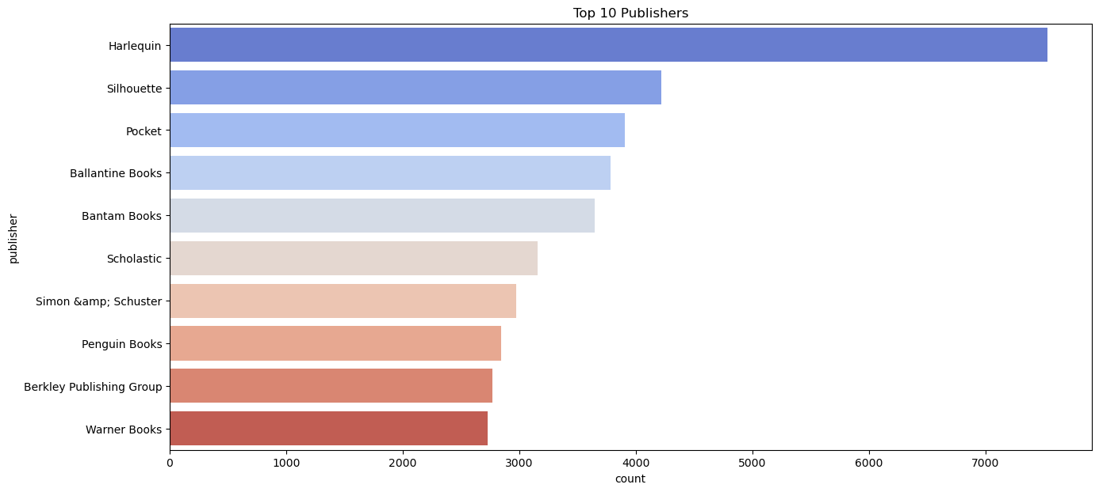
2. Top 10 Publishers with Most Books Published

Slide 9
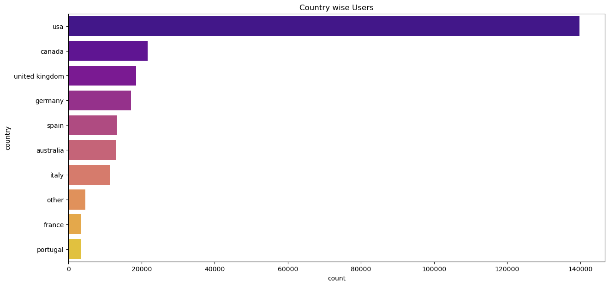
3 . Country wise Users

Slide 10
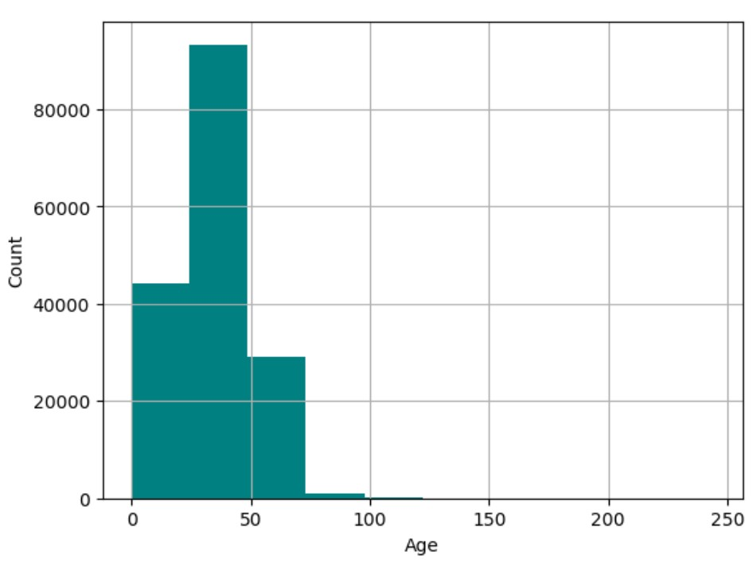
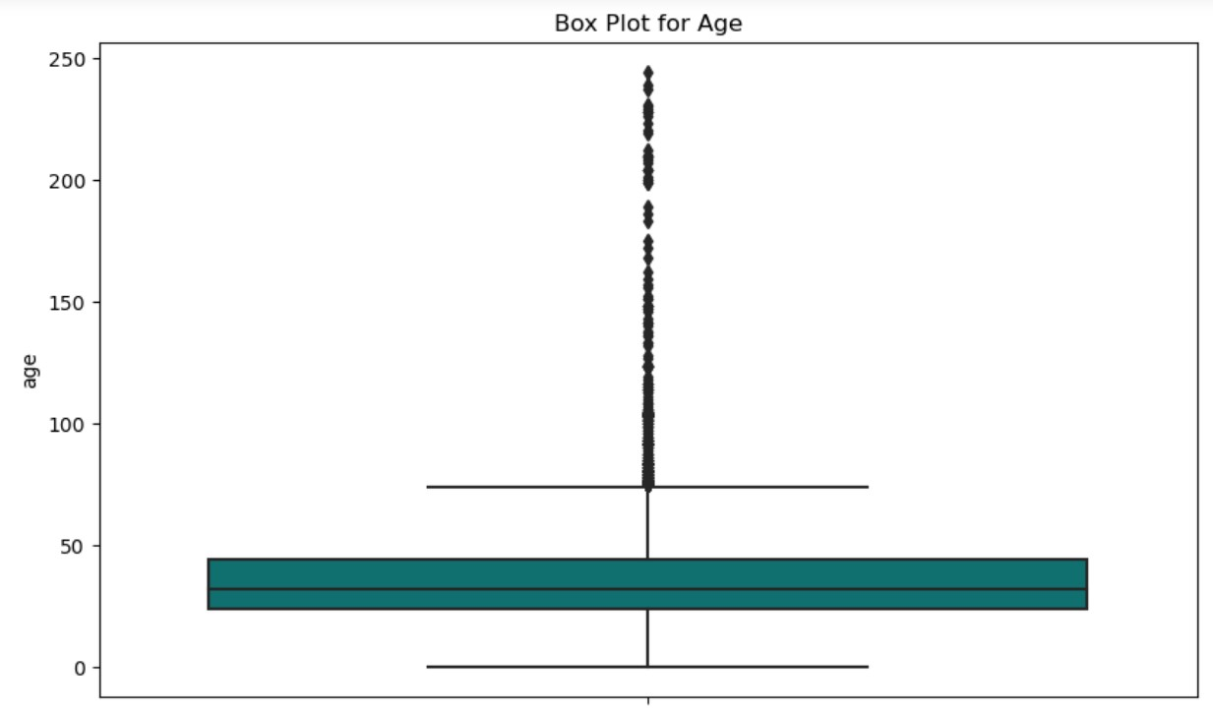
4. Age Distribution
The majority of users fall between 20 and 50 years old, with some outliers up to 250 years. The user age distribution is heavily skewed towards younger ages.

Slide 11
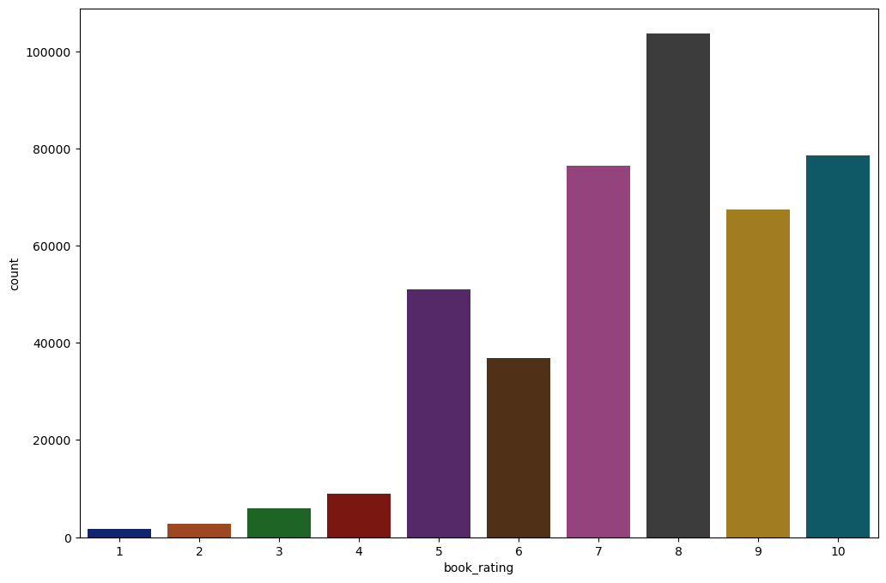
5 . Ratings Distribution
It can be observe that higher ratings are more common amongst users and rating 8 has been rated highest number of times.

Slide 12
Model Building
Recommendation Techniques
1. Recommendations based on Rating Counts
2. Popularity-Based Recommendation System
3. Collaborative Filtering

Slide 13
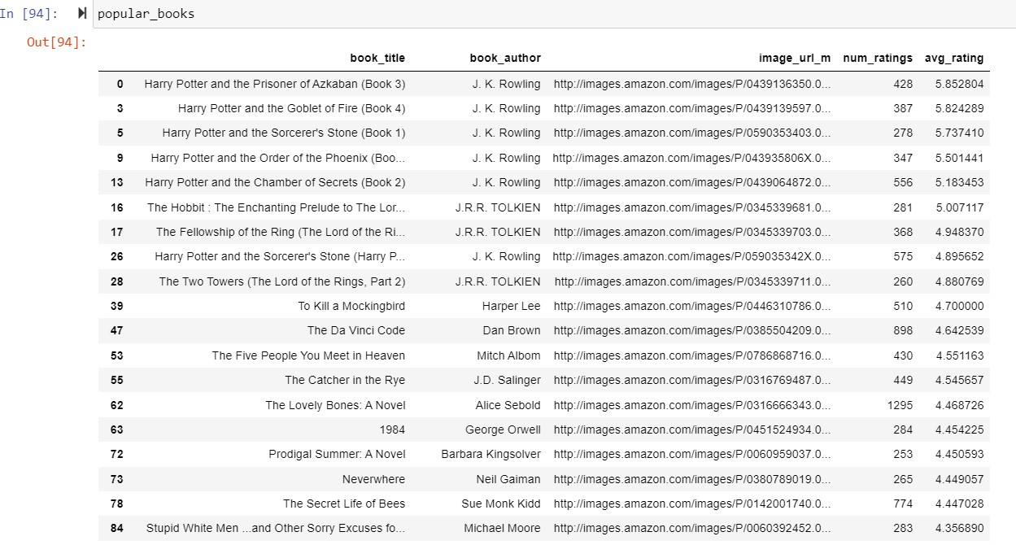
1. Recommendations based on Rating Counts

Slide 14
2. Popularity Based Recommendation System Dataframe

Slide 15
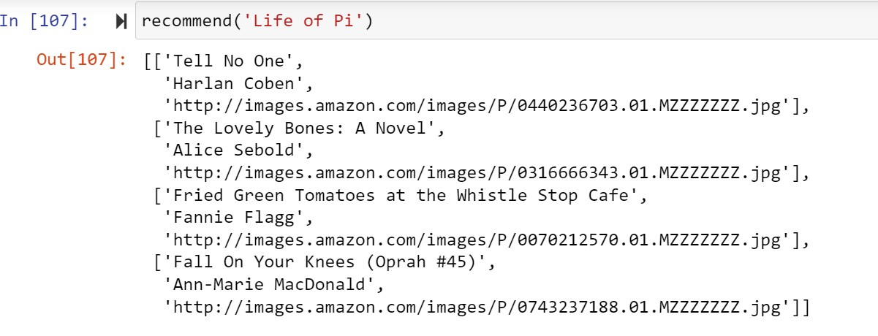
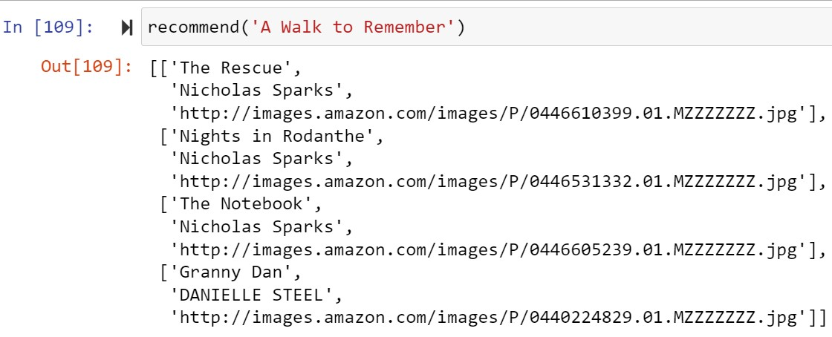
3. Result of Collaborative Filtering

Slide 16
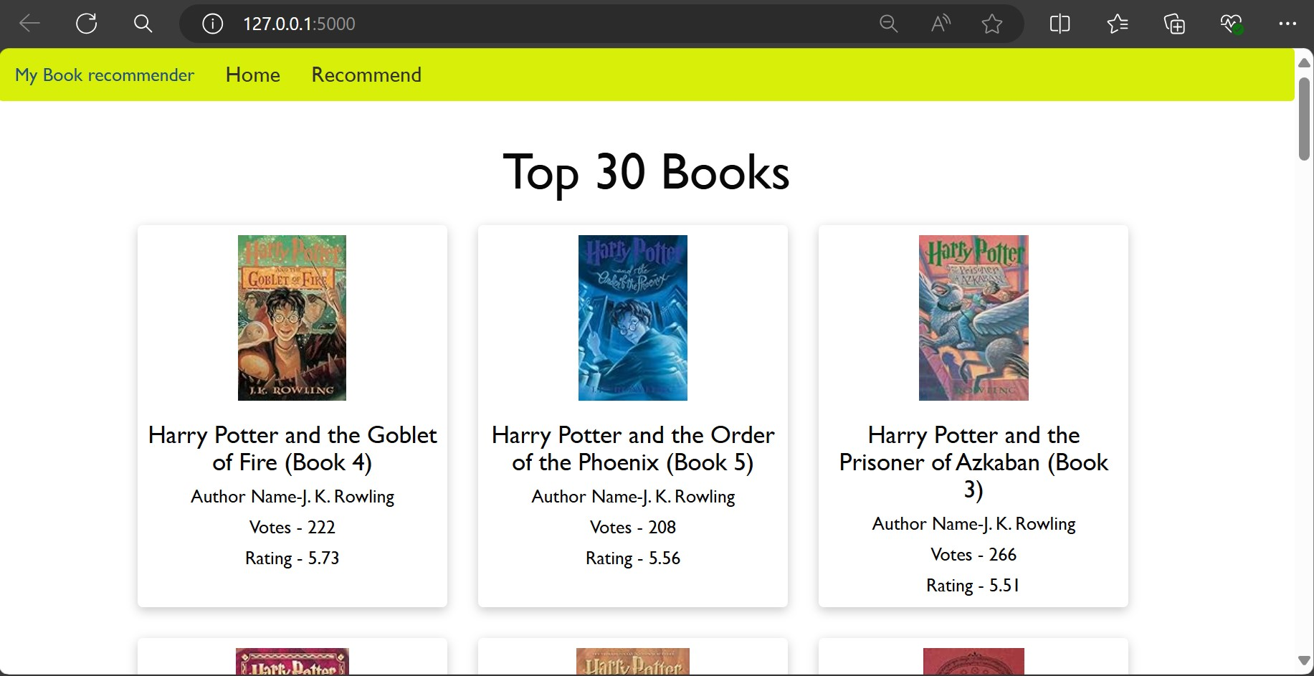
Deployment

Slide 17


Slide 18
Challenges and Solutions
1. Data Integration
Combining multiple datasets (books, ratings, users) while maintaining data integrity was challenging. Ensuring that the merged dataset was correctly aligned and free of redundant or missing values was crucial.
Solution:
Used consistent encoding and ensured the datasets were read and merged correctly. Performed multiple merges between the books, ratings, and users datasets, followed by dropping rows with null values to maintain data integrity.
2. Data Quality Issues
Encountered missing values, duplicated records, and inconsistent data formats in the dataset.
Solution:
Applied data cleaning techniques such as imputation for missing values and removal of duplicates.
3. Clustering and Model Training
High computational cost and memory usage during clustering and model training.
Solution:
Utilized KMeans for clustering and optimized it by selecting appropriate number of clusters.

Slide 19
4. Feature Engineering and Encoding
Difficulty in transforming categorical features into numerical representations for machine learning models.
Solution:
Used one-hot encoding for categorical variables and hashing for high cardinality features to maintain memory efficiency.
5. User Age and Ratings Filtering
Filtering the data based on user inputs for age and book ratings required careful handling to ensure accurate and meaningful subsets of data.
Solutions:
To create a more accurate and meaningful subset of data, we filtered the data to include only users who had rated more than 200 books and books that had more than 100 reviews. This approach helps to focus on active users and popular books, ensuring the analysis is based on significant data points.

Slide 20
Thank You

